Slide 1
Telephone Entry Systems
High-Tech Solutions for Today's Building
Communication Needs
Brought to you by:

Slide 2
Telephone Entry
Telephone entry intercoms are ideal for many different applications. Since telephone entry systems work through the phone lines, intercom wires do not need to be run. This makes this system ideal for a retrofit OR a new system. Ease of installation and ease of use makes Telephone Entry ideal for your next multi-unit application.

Slide 3
What is the difference between ‘Phone-Bill’ and ‘No Phone-Bill’ Telephone Entry Systems?

Slide 4
What is the difference between ‘Phone-Bill’ and ‘No Phone-Bill’ Telephone Entry Systems?
A ‘Phone-Bill’ (a.k.a. ‘dialer’) system is one in which the tenant may be charged a surcharge by the phone company whenever a call is placed to the apartment through the lobby (entrance) or concierge panel. A ‘No Phone-Bill’ system has added electronics that eliminate the call surcharge. Most systems can be sold as a ‘Phone-Bill’ (‘dialer’) system the way they are and can be easily changed to the ‘No Phone-Bill’ type at any time.

Slide 5
Advantages and Disadvantages of a ‘Phone-Bill System’
Advantages Disadvantages
Less expensive upfront
Call from lobby panel can be programmed to ANY valid phone number
Easiest to install
Reoccurring monthly phone company fees and surcharges
No built-in ‘call waiting’ feature
Requires a phone-line or phone service (landline/cellular)

Slide 6
Advantages and Disadvantages of a ‘No Phone-Bill System’
Advantages Disadvantages
No reccurring phone company charges
No message units
Built-in internal call waiting
No phone line needed to use intercom
More expensive upfront
Call from lobby panel can only be programmed to one apartment
Longer install time
Requires wiring to each apt. phone

Slide 7
Telephone Entry
TE903
TE904
TE7210/LCD

Slide 8
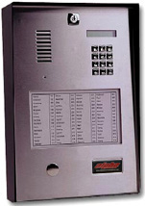
TE903
The TE903 Series telephone entry intercoms are fully surface mount St. Steel faceplate master stations. They can be used with 1 to 1,000 remote apartment telephone locations. A built-in (100 capacity) paper alphabetical directory makes finding the tenant’s calling code very easy, even in larger buildings.

Slide 9
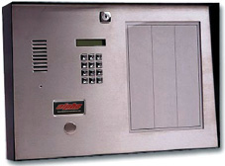
TE904
The TE904 Series telephone entry intercoms are fully surface mount St. Steel faceplate master stations. They can be used with 1 to 1,000 remote apartment telephone locations. A built-in (200 capacity) paper alphabetical directory makes finding the tenant’s calling code very easy, even in larger buildings.

Slide 10
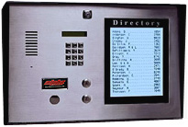
TE7210/LCD
The TE7210/LCD Series telephone entry intercoms are fully surface mount St. Steel faceplate master stations. They can be used with 1 to 700 remote apartment telephone locations. A built-in (700 capacity) LCD alphabetical directory makes finding the tenant’s calling code very easy, even in larger buildings.

Slide 11
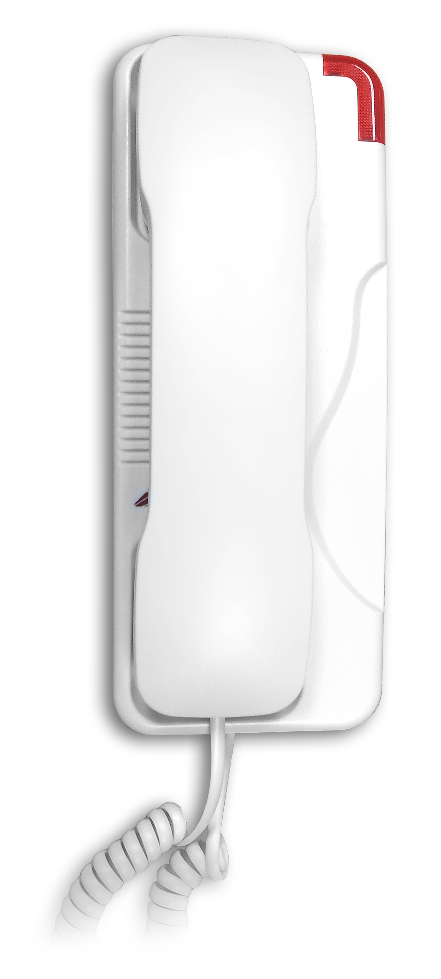
Dummy Phone
A ‘Dummy Phone’ may be used in a situation in which the apartment tenant does not have a telephone connected to the phone company lines (for a ‘no-phone bill’ system). The high-intensity flashing red indicator lamp makes this phone a perfect solution for hearing-impaired tenants.

Slide 12
At Alpha Communications ® we are here for your Telephone Entry needs. Please feel free to contact us anytime with any questions or system requirements you may have.
We can be reached TOLL-FREE at 1-800-666-4800 or
on our website: www.AlphaCommunications.com
We look forward to hearing from you and helping you with
your next system. We hear you!
Copyright©2000-2018 Alpha Communications® All Rights Reserved

